Slide 1

Clinic Management System
Team 6 – Paradigm
Santórum Sandoval Thais Yetsalem.
Toapanta Orejuela Adrian Michael
Vargas Pérez César Alexander
Notes:
Interlineado + Números de página

Slide 2

Index
01 Introduction
02 Problem
03 Overview
04 Background
05 Analyst comparison.

Slide 3

Introduction
01
We chose to develop a clinic management system to solve problems caused through the use of a patient database.

Slide 4

Problem
02
The problem we aim to solve with this project involves a clinic that serves multiple clients and records their information in a notebook. Over time, it became clear that the notebook was not the most effective way to manage client records.

Slide 5

Overview
03
Patients need clinics to be well organized.
Proper management of appointments and medical information helps patients understand their treatments.
A clinic management system simplifies these processes.
Patients can efficiently track treatments, making their experience more practical, organized, and reliable.

Slide 6
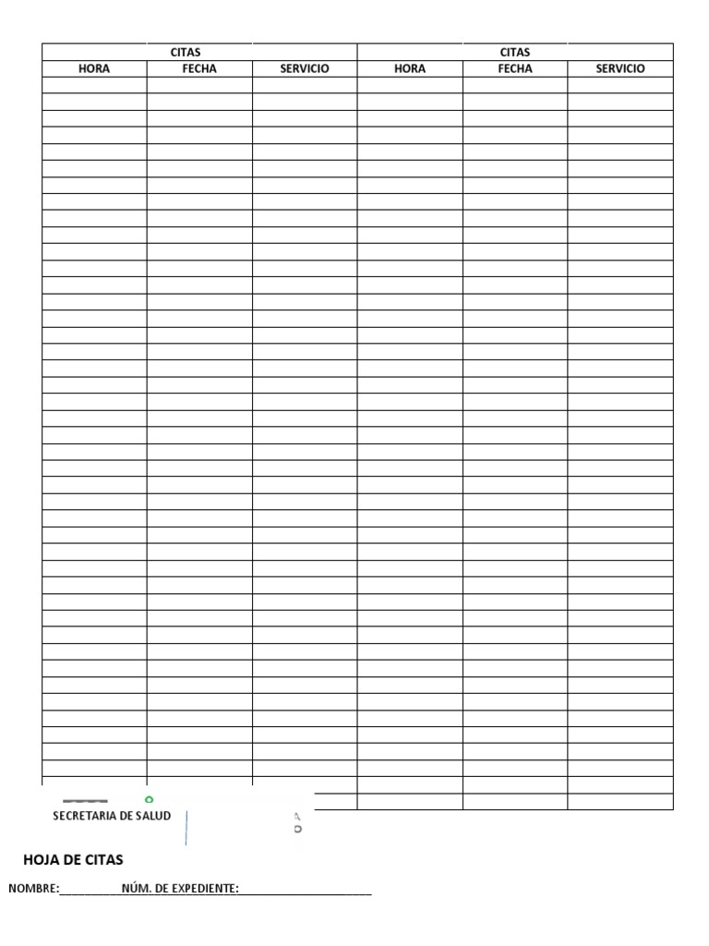
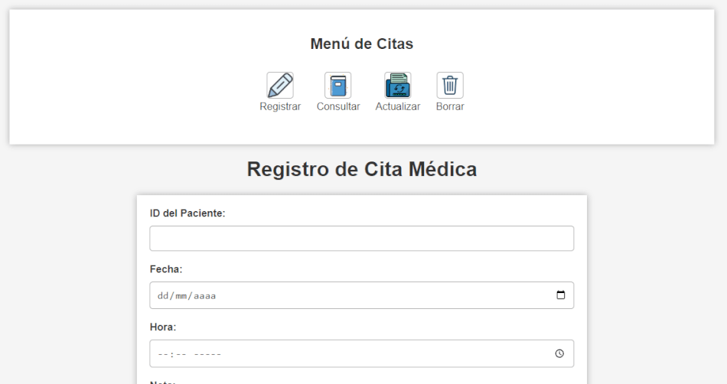
Background
04
Before
The paper appointment book causes errors, double-bookings, and wastes valuable staff time, this outdated system limits efficiency and creates frustration.
The clinic urgently needs digital modernization to ensure quality and optimize management
After

Slide 7
System Analysis
05
The proposed system will digitize the clinic’s operations, replacing manual recordkeeping.
Patients will be able to register, book, modify, or cancel appointments, check specialist availability, and view their treatment history.
Specialists will access patients’ clinical records, manage schedules, and update treatments securely.
The system will prevent scheduling conflicts, reduce human error, and improve coordination.
Overall, it will enhance efficiency, organization, and the patient experience.

Slide 8

Functionalities
06
The Clinic Management System is designed for the management of the Toamedical clinic and focuses on the interactions between Administrators, Receptionists, Patients, Doctors, Appointment Management, Medical Records, Billing and Prescriptions.

Slide 9

Funtionalities
07
The system will allow the user to save, edit, delete and search the necessary information through a menu that allows interaction with these functionalities.

Slide 10
Thank you !

